Slide 1
ELE4909 Traction and Drives
Motor Control Circuits

Slide 2
Motor Control Circuits
Identify and application of electrical components
Recognize terminology and symbols of control wiring diagram
Select suitable electrical components for installing motor control circuits
Apply the wiring technique to Install motor control circuits
Apply the technique for the testing and fault finding of motor control circuits

Slide 3
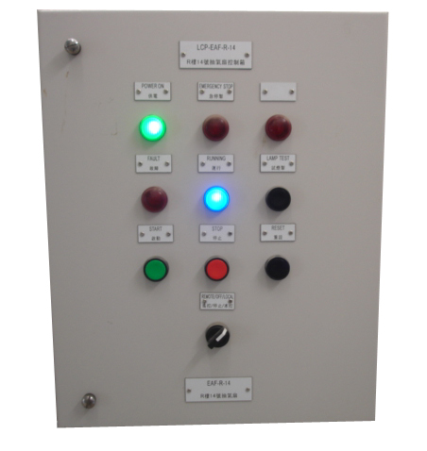
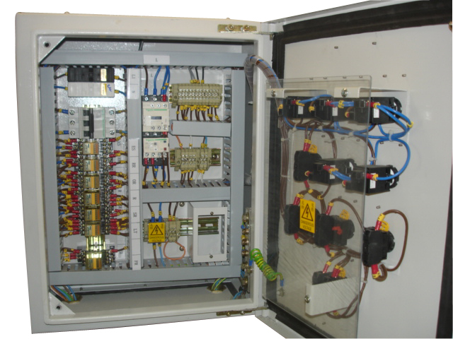
Control Panel

Slide 4
Protection and Components
Overcurrent protective devices
Electrical control components

Slide 5
Overcurrent Protective Devices
Moulded Case Circuit Breaker, MCCB
Miniature Circuit Breaker, MCB
Fuse-switch
Fuse

Slide 6
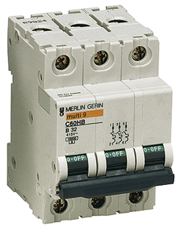
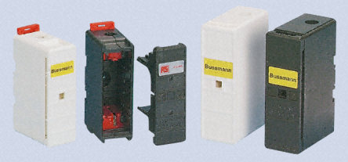
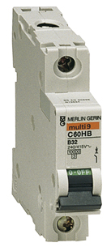
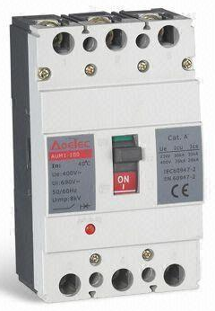
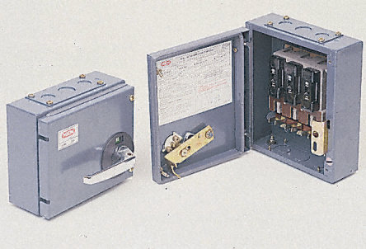
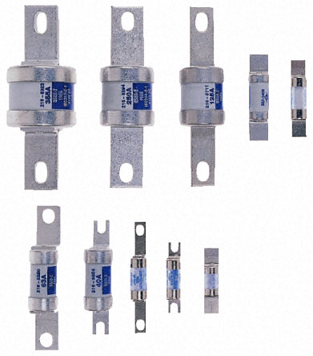
Overcurrent Protective Devices

Slide 7
Electrical control components
Magnetic contactor
Thermal overload relay
Auxiliary relay
Delay timer
Push Button Switch
Selector switch
Indication lamp
Sensors (e.g. water level, water pressure and limit switch etc.)

Slide 8
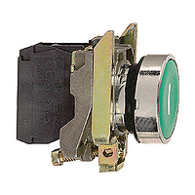
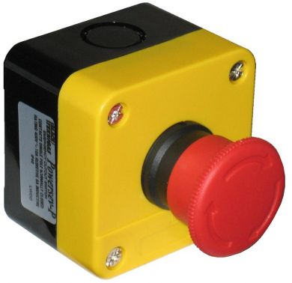
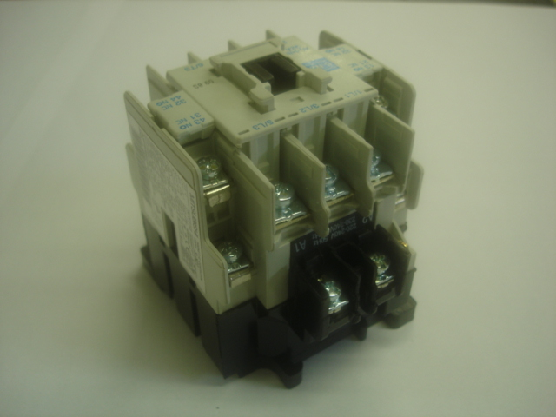
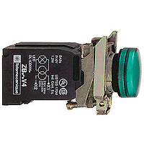
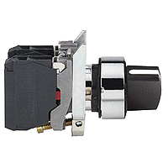
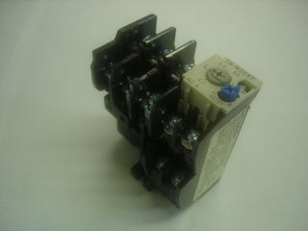
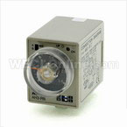
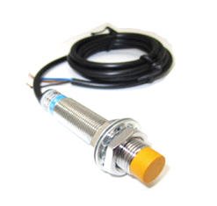
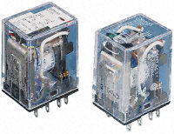
Electrical control components

Slide 9
Magnetic Contactor
Main contacts, 3-pole or 4-pole, rated current capacity from 20A to 800A
Auxiliary contacts, rated current capacity 5A
Coil voltage: AC 24V – 380V and DC 24V – 110V

Slide 10
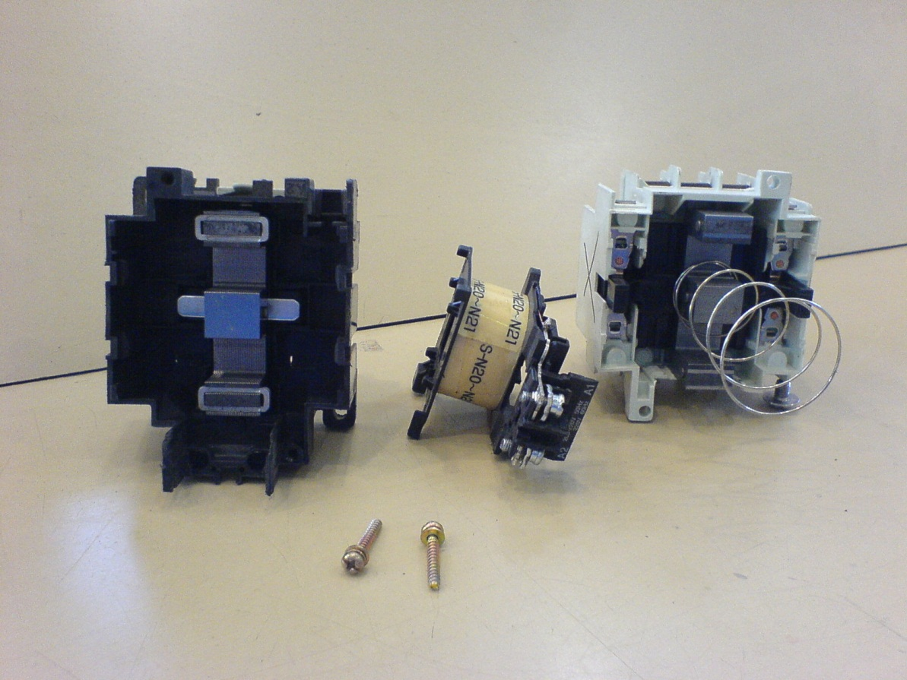
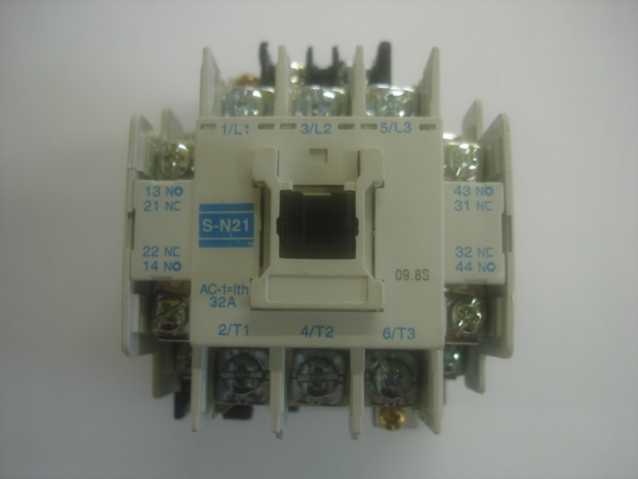
Magnetic Contactor
Parts of magnetic contactor

Slide 11
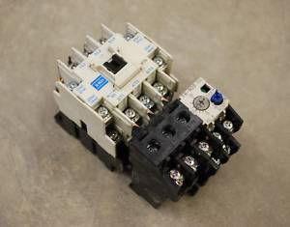
Magnetic Contactor
Magnetic contactor c/w thermal overload relay

Slide 12
Thermal Overload Relay
Heat element, rated current capacity from 2A to 200A
Auxiliary contact, 5A

Slide 13
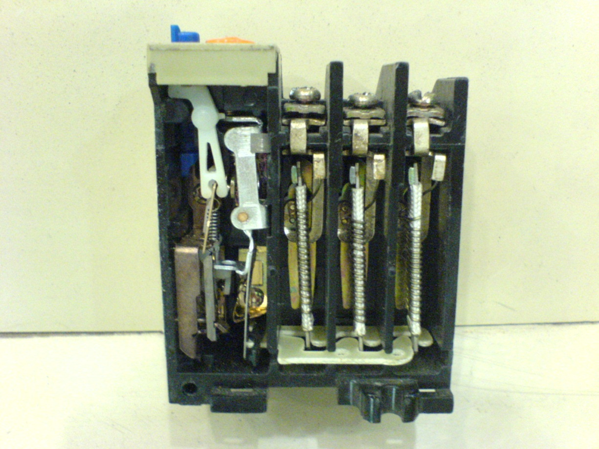
Thermal Overload Relay
Picture shows the inside parts

Slide 14
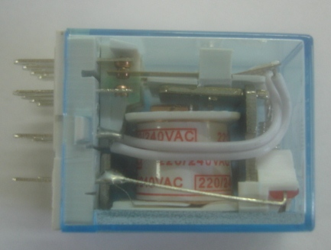
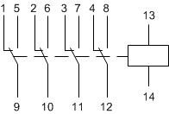
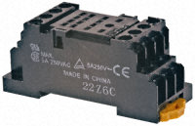
Auxiliary Relay

Slide 15
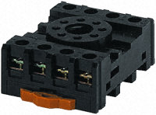
Delay Timer Relay

Slide 16
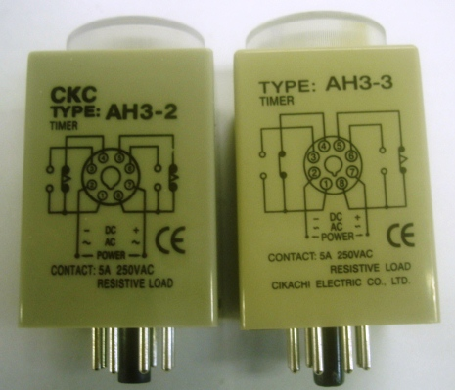
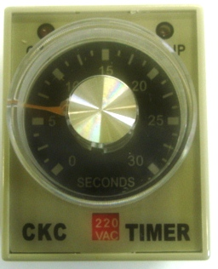
On-delay Timer Relay

Slide 17
On-delay Timer Relay

Slide 18
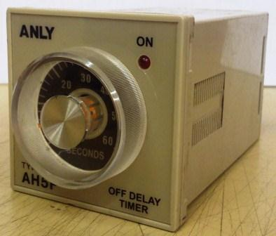
Off-delay Timer Relay

Slide 19
Control Switch and Indication
Push Button Switch
Selector switch
Indication lamp

Slide 20
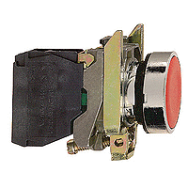
Push Button Switch

Slide 21
Selector switch

Slide 22
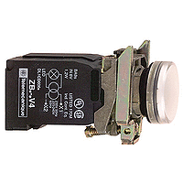
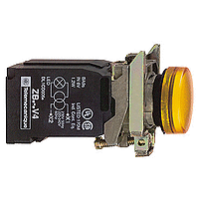
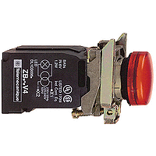
Indication lamp

Slide 23
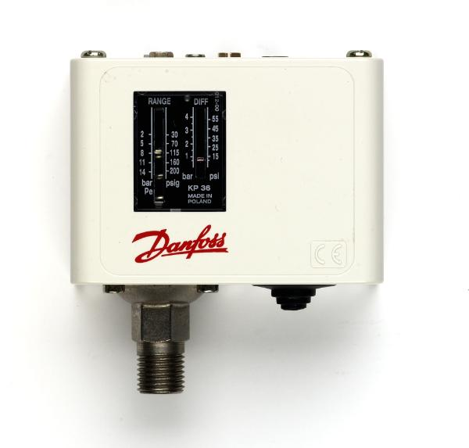
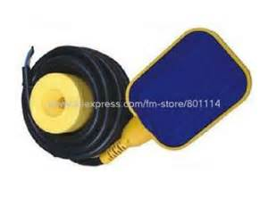
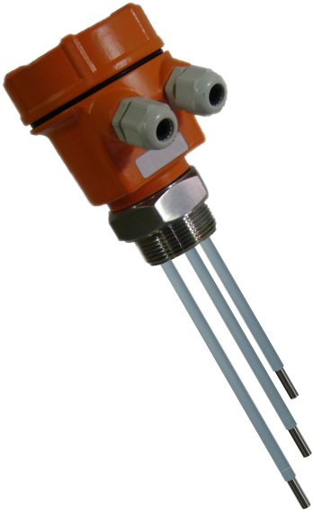
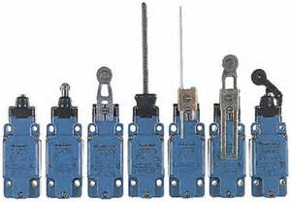
Sensors
Pressure switch
Level flow sensor and switch
Limit switch

Slide 24
Control Wiring Diagram
Components’ Terminology
and
Symbols

Slide 25
Symbols
Type | Device | Symbol | Word
Circuit breaker | MCB / MCCB |  | MCB / MCCB
Switch (Isolator) | 3-pole switch |  | QS
Fuse-switch | 3-pole Fuse-switch |  | QF

Slide 26
Symbols
Type | Device | Symbol | Word
Fuse | Fuse |  | FU
Link | Neutral link |  | NK
Contactor | Coil |  | KM

Slide 27
Symbols
Type | Device | Symbol | Word
Contactor | Main contact |  | KM
Contactor | Auxiliary contact (normal open) |  | KM
Contactor | Auxiliary contact (normal close) |  | KM

Slide 28
Symbols
Type | Device | Symbol | Word
Auxiliary relay | Coil |  | KA
Auxiliary relay | Auxiliary contact (normal open) |  | KA
Auxiliary relay | Auxiliary contact (normal close) |  | KA

Slide 29
Symbols
Type | Device | Symbol | Word
Thermal overload relay | Heat element |  | FR
Thermal overload relay | Normal open contact |  | FR
Thermal overload relay | Normal close contact |  | FR

Slide 30
Symbols
Type | Device | Symbol | Word
On-delay timer relay | On-delay coil |  | KT
On-delay timer relay | On-delay contact (N.O.) |  | KT
On-delay timer relay | On-delay contact (N.C.) |  | KT

Slide 31
Symbols
Type | Device | Symbol | Word
Off-delay timer relay | Off-delay coil |  | KT
Off-delay timer relay | Off-delay contact (N.O.) |  | KT
Off-delay timer relay | Off-delay contact (N.C.) |  | KT

Slide 32
Symbols
Type | Device | Symbol | Word
Push button switch | Normal open contact |  | SB
Push button switch | Normal close contact |  | SB
Push button switch | Combine contact |  | SB

Slide 33
Symbols
Type | Device | Symbol | Word
Push button switch | Emergency stop switch (self-lock) |  | SB
Selector switch | Selector switch |  | SA
Indication | Indication lamp |  | L

Slide 34
Symbols
Type | Device | Symbol | Word
Limit switch | Normal open contact |  | SQ
Limit switch | Normal close contact |  | SQ
Limit switch | Combine contact |  | SQ

Slide 35
Symbols
Type | Device | Symbol | Word
Motor | 3-phase AC induction motor |  | M
Motor | 3-phase AC slip-ring induction motor |  | M
Transformer | Auto-transformer |  | Tx

Slide 36
Control Wiring Diagram
The diagram that divided into two parts
Main wiring
Control wiring
Read the diagram from top to down, then left to right

Slide 37
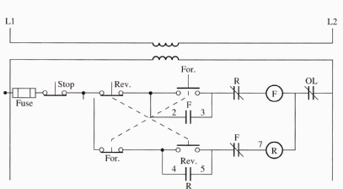
Control Wiring Diagram
Other type of symbols

Slide 38
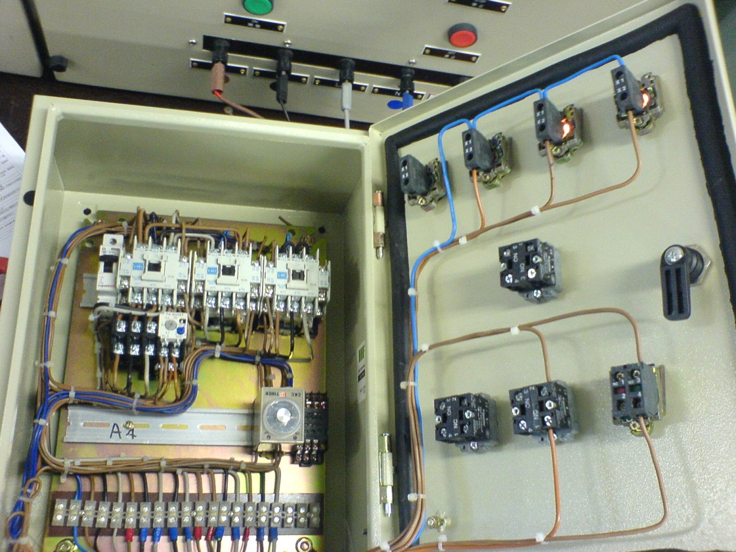
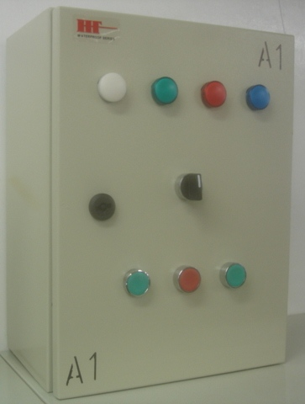
Workmanships

Slide 39
Motor Control Circuits
Motor Starting Methods
for
3-ph AC Induction Motor

Slide 40
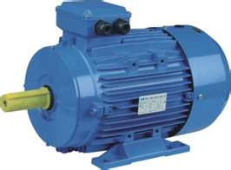
Induction Motor Starting Methods
Direct on line starter
Star-delta starter

Slide 41
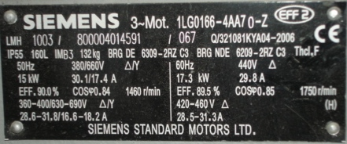
3-ph AC Induction Motor
Motor name plate

Slide 42
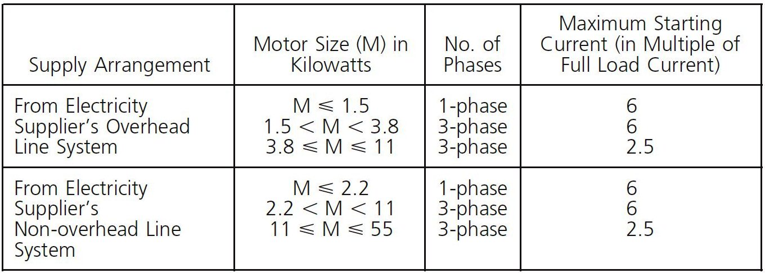
Relevant CoP Requirement
Refer to CoP code 26C(3)

Slide 43
Direct on line starter

Slide 44
Star-delta Starter
3-ph Induction Motor Winding

Slide 45
Star-delta Starter
Motor terminal

Slide 46
Star-delta Starter
Current/speed characteristics
Torque/speed characteristics

Slide 47
Star-delta Starter

Slide 48
Motor Control Circuits
Rotate Direction
for
3-ph AC Induction Motor

Slide 49
Change Rotate Direction
Interchange any two of the supply cables
To prevent mal-operation, provide interlock device/circuit is necessary

Slide 50
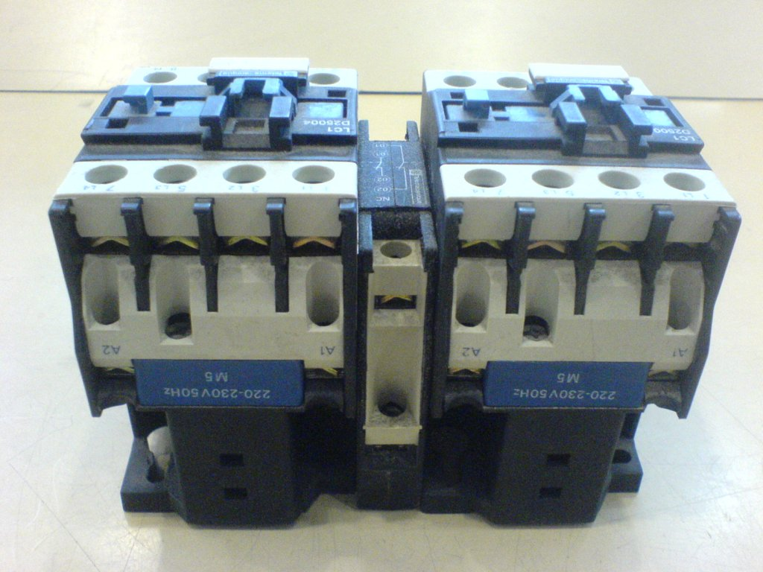
Interlock Device
Interlock by auxiliary contact
Mechanical interlock

Slide 51
Forward/Reverse Starter

Slide 52
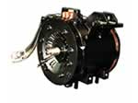

Slide 53
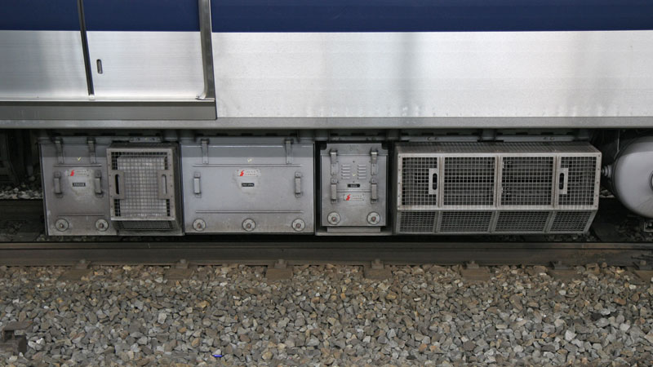
IGBT VVVF

Slide 54
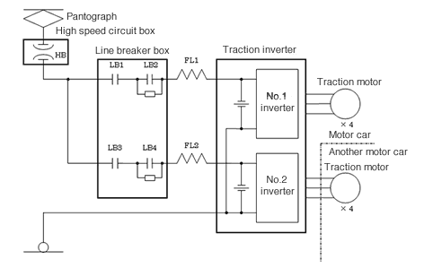
Pantograph to motor

Slide 55
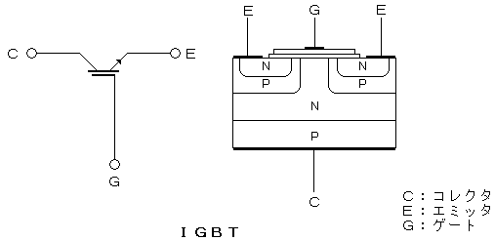
IGBT component

Slide 56
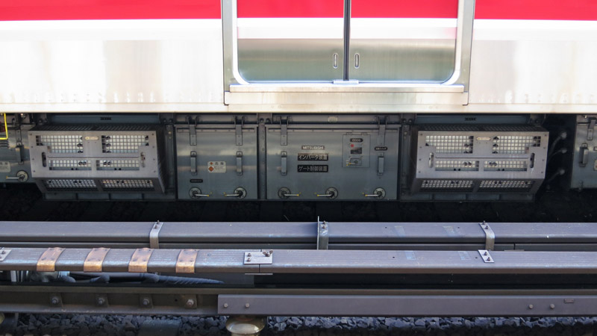

Slide 57
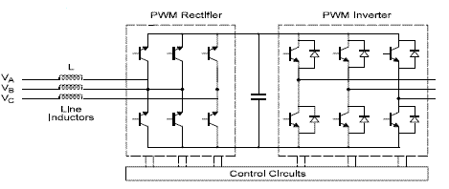
Rectifier to inverter

